Slide 1
Criminal Justice & Criminology Spring 2019

Slide 2
Student engagement in the SPRING 2019 Victimology, Introduction to Forensic Science, Juvenile Delinquency, and Contemporary Issues in CJ: Terrorism courses
Dr. Pavlik’s students gained valuable Information from presentations by various guest speakers this semester.
Students participated in a search demonstration and met with prominent people within the community as they explored important topics in the field of criminal justice & Criminology.

Slide 3
Conducting Searches
John Clouse, Deputy Director of the Daviess County Emergency Management Agency, organized the Search & Rescue (DCSAR) team and coordinated several classroom lectures on search patterns, and other methods/techniques used to locate/track a missing person. Some of the topics discussed in the 3 classroom sessions included man tracking and the Scent Theory. Several members of the SAR participated in this learning experience.

Slide 4
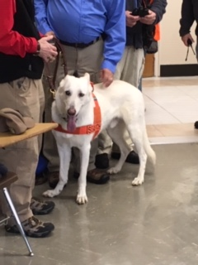
SAR Jim Huff and K-9 Max performed an on-campus demonstration for the Introduction to Forensic Science class. Huff and Jacobs prepared the scent track on a Wednesday and then the search was conducted using Max during class on Friday. Students watched Max and Mr. Huff hard at work! Thanks to Christopher Ellis Jacobs for student participation in the tracking portion of this exercise.
MOCK SCENARIO:
K-9 Max performed well along side of his handler, Jim Huff. the weather was inclement during the week this activity was scheduled on campus. Students got to experience what could happen when weather as a contributing factor in a search.

Slide 5
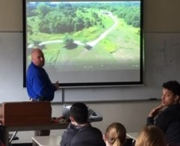
SAR use of UAV’s
The students enjoyed the informative presentation that was given during SAR week on the use of unmanned aerial vehicles (UAV’s) when used to search for missing persons over large areas and rough terrain.

Slide 6
Crime Scene Investigation
Owensboro Police Department (OPD) came to our classroom and discussed what is involved with securing a crime scene, chain of custody, evidence collection, preservation, and submission to the lab. The speakers gave an overview of the court process related to crime scene investigation, and discussed employment opportunities in law enforcement.
Owensboro Police Department 222 E 9th St. Owensboro, KY 42301

Slide 7
Juvenile Delinquency Division Supervisor at Owensboro Police Dept.
Sgt. Brandon Sims
Gave an outstanding presentation and Q&A session to students in the Juvenile Delinquency Class

Slide 8
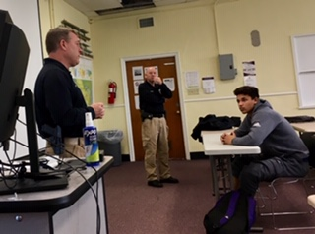
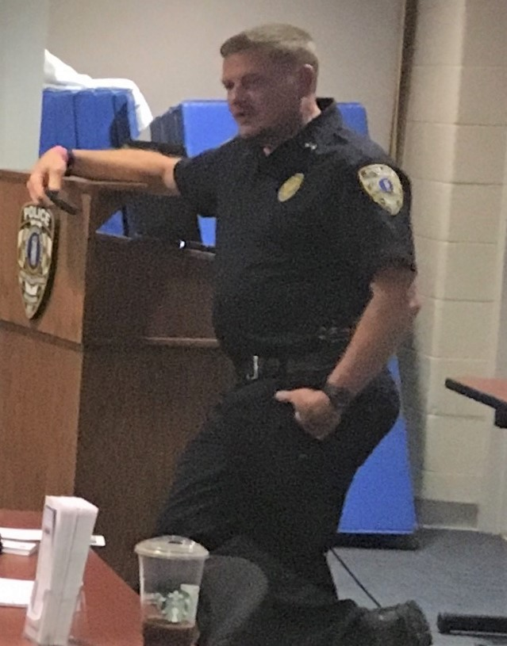
OPD crime scene presenters

Slide 9
GIS Technology
Presentation by lance Morris
GIS analyst/Programmer
101 East 4th Street,
Owensboro, KY 42303

Slide 10
Forensic Anthropology
Presentation by Luke Shockley

Slide 11
Drugs
Presented by
Dr. Jesica Thomason Mills owner of the
Owensboro Family Pharmacy and Wellness
720 W. Byers Ave
Owensboro, KY 42303

Slide 12
KWC presented various forensic topics
Dr. Janella Moy
Dr. David Oetinger
Dr. Paula Dehn
Associate Professor
presented 1 class session on Forensic Nursing
Emeritus Professor presented 3 class sessions on Serology
VP of Academic Affairs
presented 3 class sessions on toxicology

Slide 13
Battalion Chief Steve Leonard
Presented 3 class sessions
on Arson Investigation

Slide 14
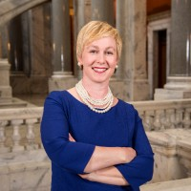
Human Trafficking Awareness
KY Office of the Attorney General
Teleconference
Second Life of TN
Gretchen Hunt
Director, Office of Victims Advocacy
Louisville, Kentucky
Government Administration
Jerry Redman, CEO, spoke to the students about the role that a nongovernment organization (NGO) plays in trafficking awareness and victim services.
PO BOX 25485
Chattanooga, TN 37422
Website: Secondlifetn.org
Due to the proximity of the speaker’s employment in relation to the KWC campus, Ms. Hunt and Mr. Redman delivered important information with a PowerPoint via teleconference and computer technology.
This was a new “in class experience” for students in an effort to receive information on human trafficking awareness. Students were also able to have their questions answered on this topic by the KY Office of the Attorney General and a Nongovernment Organization (NGO).

Slide 15
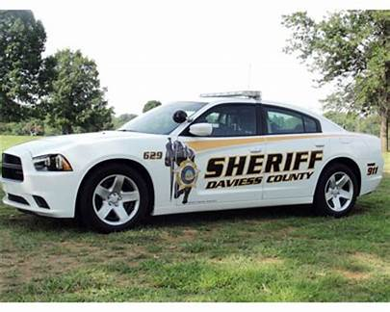
Daviess County Sheriff’s Office
Major Barry Smith, Chief Deputy, gave the students an overview about the Sheriff’s Office.
Lt. Roby gave the students the grand tour of the Sheriff’s Office facility.
Students spoke to personnel in various departments within the SO to include the Evidence Section, OPS, Communications Center, CID, Patrol, and the Narcotics Unit.
Employment and internship options were also discussed with students during the Q & A.
Daviess County Sheriff’s Office
212 St. Ann Street
Owensboro, KY 42303

Slide 16
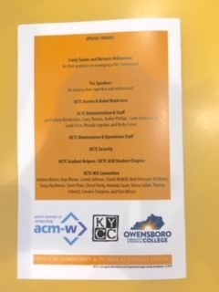
Women in Computing (WIC)
Several students attended the WIC conference with Dr. Pavlik held at OCTC which included workshops and lectures on the use of technology.
This two day conference was was not just for women but held to empower more women to get into this line of work after college graduation.

Slide 17
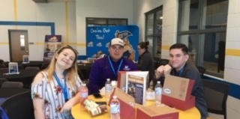
WIC attendees
Location of Conference: OCTC

Slide 18
Presentation given on cell phone technology as it related to criminal investigations
Cheryl A. Purdy, MBA, A+, CCNA, CDFE, ACE, CCCE, CTT+ CompTIA SME
Associate Professor of Computer and Information Technology
Digital Forensic Examiner, Daviess County Sheriff’s Office
Owensboro Community and Technical College

Slide 19
Daviess County Judicial Center
Students met with District Court Judge Lisa Jones and Karen Martin at the Judicial Center.
Ms. Martin coordinated an info session with Judge Jones in one of the courtrooms. Students got to speak with Judge Jones on various issues including juvenile delinquency and she gave them an overview of the judicial process in the criminal justice system.

Slide 20
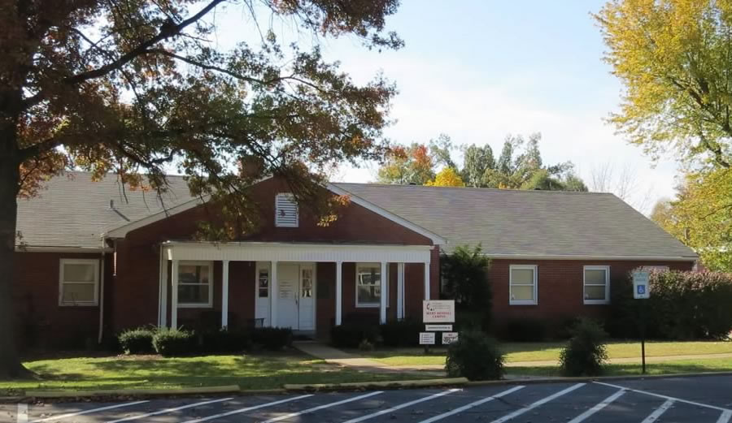
Roy Hicks Resources Coordinator
Students toured the Campus of the Mary Kendall House.
Students were given an overview of the entry and release process from the site.
Employment options were discussed.
Methodist Home of KY, Inc.
193 Phillips Ct, Owensboro, KY 42303
Mary Kendall Residential Treatment and Emergency Shelter Program for adolescent to teens.

Slide 21
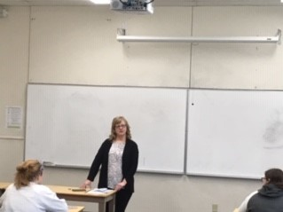
New Beginnings Terri Crowe, Guest Speaker, on victim rights
New Beginnings
Sexual Assault support services, INC.
Owensboro, KY

Slide 22
New Beginnings Laundry of Love Program
Students participated in the Laundry of Love program at New Beginnings. Students made survivor kits for victims. The Laundry of Love program offers clothing and toiletries to survivors after the forensic exam. Many assault survivors must give their clothing to the police when they arrive at the hospital. Law enforcement officers often need the victim’s clothing for evidence in the criminal investigation of the assailant

Slide 23
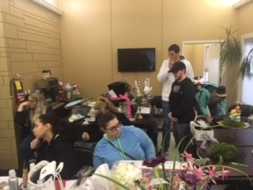
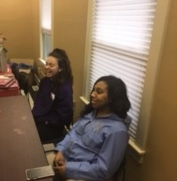
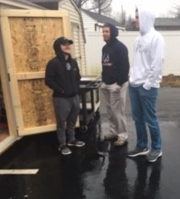
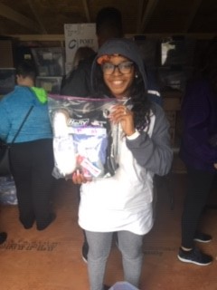
Laundry of Love Program

Slide 24
Guest Speakers discussed service learning options for Fall 2019
Ryan Bibb
Ashley Dumas
Please see
these websites
for information on how to become involved as a volunteer and/or Ambassador.
Service Learning will continue as service learning sites

Slide 25
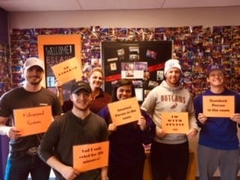
Escape Room Team Building Activity Students worked together to find clues from the Titanic scenario to solve the case in one hour or less.

Slide 26
KWC Scholar’s Day
Scholars Day, students from any discipline share the results of their creative, research and scholarly work. Scholars Day format is a finished poster set up on an easel where students discuss their work with guests as they walk around the room. Posters have included research projects on biology, chemistry, criminal justice, art education, music, and theatre.
April 2019: The event had the biggest turn out for Scholar’s Day by Criminal Justice & Criminology students. Dr. Pavlik oversaw research for 36 student projects from research done in the format of a formal memo to government officials and agencies, and proposals to government officials domestically and internationally ranging from juvenile drug use, school drop outs, and labor trafficking issues abroad.

Slide 27
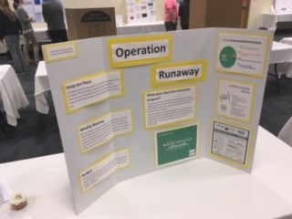
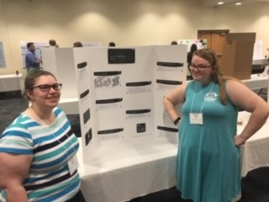
Scholar’s Day

Slide 28
Scholars Day Serve KY recognition certificates
Students that took the Corrections class with the 40 hour service learning component in Fall 2018 were recognized by Serve KY for their volunteer hours and received a certificate on Scholar’s Day.

Slide 29
This slideshow also recognizes student success in achieving an internship, employment at the KSP, and academic attendance at the National Forensic Academy.
KWC students at their best!!!

Slide 30
Chandler Adams
Participated in a Summer 2019 internship at the Las Vegas Metropolitan Police Department

Slide 31
Jonah Brawner
Jonah was a recent KWC graduate who got accepted into the Kentucky State Police Academy Summer of 2019.
The Kentucky State Police Academy is an intense, 24-week military environment designed to teach our Cadets the job skills necessary to perform the duties of a Trooper. Those selected to attend our Academy will receive more than 1,000 hours of training covering all aspects of law enforcement, including Firearms, Defensive Tactics, Criminal Investigations, Emergency Driving, Strategies and Tactics of Patrol Stops (STOPS), Counter-Ambush, and more.

Slide 32
Alyssa Nichols
Ms. Nichols completed her training this Summer for the position of
Daviess Court Security Officer (Bailiff).
Some of the responsibilities of court security officer (Bailiffs) include, but are not limited to:
1. Safety of the judge and courtroom employees
2. Transportation of prisoners to and from court.
3. Making sure all holding cells are checked periodically during the day and are vacated of inmates at the end of the day.
4. Being physically in the courtroom when court is in session.
Ms. Nichols will speak to students in the Fall 2019 with regard to her new employment opportunity in Owensboro.

Slide 33
Campus wide event held
#WEAR BLUE Campaign on human trafficking awareness

Slide 34
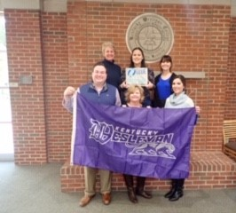
#WEAR BLUE: January 11, 2019 National Human Trafficking Awareness Day
This event was coordinated by Dr. Pavlik to raise awareness about human trafficking. This was a first time event held on the KWC campus. Students, faculty, & staff participated by wearing blue clothing and submitting their photo to the KWC social media sites for upload. This awareness campaign was a huge success and all the participant photos can be found on the KWC social media siteS There was also some community participation of phots uploaded to include new beginnings.
For more information on this national campaign event, visit this link: https://www.dhs.gov/blue-campaign/wearblueday

Slide 35
Prepare for the Jan 11, 2020 Event

Slide 36
A great deal of time and preparation went into the development of an interactive semester for students to experience during Spring 2019. Organizing and coordinating classroom guest speakers, field trips, activities, and demonstrations were done to enhance student learning to supplement textbook material. This allowed the students to actively engaged with the community and consider occupations they may not have given any thought to prior to Spring 2019 in the field of criminal justice and criminology.
Dr. Pavlik would like to thank all the people, organizations, departments, NGO’s, government entities, and agencies that participated in making the KWC Spring 2019 Criminal Justice & Criminology semester a success for her students.
Dr. Pavlik looks forward to working with all the community in the future!

Slide 37
Student participation and class fieldtrip photos can be viewed on the KWC social media sites.
For more information on KWC criminal justice and criminology courses, contact Dr. Kimberly Pavlik, Program Coordinator and Professor
Email: Kimberly.Pavlik@Kwc.edu
Office: 270-852-3219

